Slide 1

Measuring Vm usage stats with PowerShell
Using PowerShell to Measure Hyper-V Virtual Machine Resources, Status, and Statistics
Robert Borges (MVP)

Slide 2


Who am I
Robert “Bob” Borges
Follow Me:
Chief Information Officer Bay State Integrated Technology, Inc.
2017 Microsoft MVP Awarded for Azure
President of Boston User Groups, Inc.
President of IT-Pro User Group
Blog: www.RobertBorges.us
E-mail: Bob@RobertBorges.us
Twitter: @RobertBorges_us
LinkedIn: linkedin.com/in/robert-borges

Slide 3
Why PowerShell for This?
Built-in GUI tools are great for monitoring live performance, but not as good at displaying usage stats Example: Show disk space usage for all VMs
Get verbose levels of information and feed them into the tools you prefer (Excel, Access, Visual Basic, etc.)
Quickly get information Example: on virtual machines throughout your organization

Slide 4
Considerations
What version of Windows Server are running on your Hyper-V hosts?
What version of PowerShell are you running?
Install Hyper-V on Windows Server:
Get-WindowsFeature Hyper-V
Install-WindowsFeature Hyper-V –Restart
Install Hyper-V on Windows 10:
Get-WindowsOptionalFeature -FeatureName "Microsoft-Hyper-V*" -online | Format-Table
Enable-WindowsOptionalFeature -Online -FeatureName Microsoft-Hyper-V –All

Slide 5
Definitions
“PS” = PowerShell
“VM” = Virtual Machine
“Host” = Hypervisor host running either:
Windows Server with the Hyper-V Role
Microsoft Hyper-V Server

Slide 6
Start/Stop VM from Powershell
Start all Virtual Machines on a Host: Start-VM -ComputerName localhost -Name *
Start a single Virtual Machine: Start-VM –ComputerName localhost –Name “Audit PC 1”
Stop a Virtual Machines: Stop-VM –ComputerName localhost –Name “Audit PC 1”

Slide 7
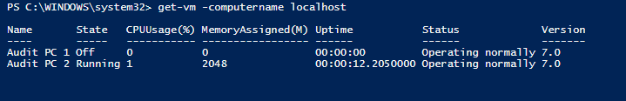
Get-VM
GET-VM gets the virtual machines from one or more Hyper-V hosts.
SYNTAX:
Get-VM [[-Name] <string[]>] [-CimSession <CimSession[]>] [-ComputerName <string[]>] [-Credential <pscredential[]>] [<CommonParameters>]

Slide 8
Get-VM Examples
View Status of a single VM: Get-VM -ComputerName localhost -Name "Audit PC 1“
View Status of all VMs on multiple Hyper-V Hosts: Get-VM -ComputerName localhost,bostonhost1,bostonhost2
View Running VMs: Get-VM | Where { $_.State –eq ‘Running’ }

Slide 9
Measure-VM
Reports resource utilization data for one or more virtual machines.
SYNTAX
Measure-VM [-Name] <string[]> [-CimSession <CimSession[]>] [-ComputerName <string[]>] [-Credential <pscredential[]>]
[<CommonParameters>]
Measure-VM [-VM] <VirtualMachine[]> [<CommonParameters>]

Slide 10
Measure-VM
RAM (average, min, and max)
CPU (average,
Total Disk
Network Inbound
Network Outbound
IOPS
Latency
Much, much, more…

Slide 11
Measure-VM Requirement
IMPORTANT:
Before Measure-VM can be used to collect information on your VMs, you must first enable the functionality for each virtual machine!
get-vm -ComputerName localhost –Name * | enable-VMResourceMetering

Slide 12
Measure-VM Examples
Display Basic Stats of a single VM: Measure-VM -ComputerName localhost -Name "Audit PC 1“
Display Basics Stats of all VMs on a Host: Measure-VM -ComputerName localhost -Name *

Slide 13
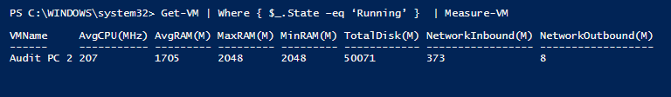
Bring them together
Get-VM | Where { $_.State –eq ‘Running’ } | Measure-VM

Slide 14


Lets make this more useful
Get-VM + Measure-VM

Slide 15
Export-CSV
The Export-Csv cmdlet makes it easy to export data as a comma-separated values (CSV) file; all you need to do is call Export-Csv followed by the path to the CSV file.

Slide 16
Export-CSV Example
Gather Stats using Measure-VM and export to a CSV:
$file_usage_current='C:\VM-Usage_current.csv'
get-vm -ComputerName BosHost1,BosHost2,BosHost3 | Measure-VM | export-csv -NoTypeInformation $file_usage_current

Slide 17
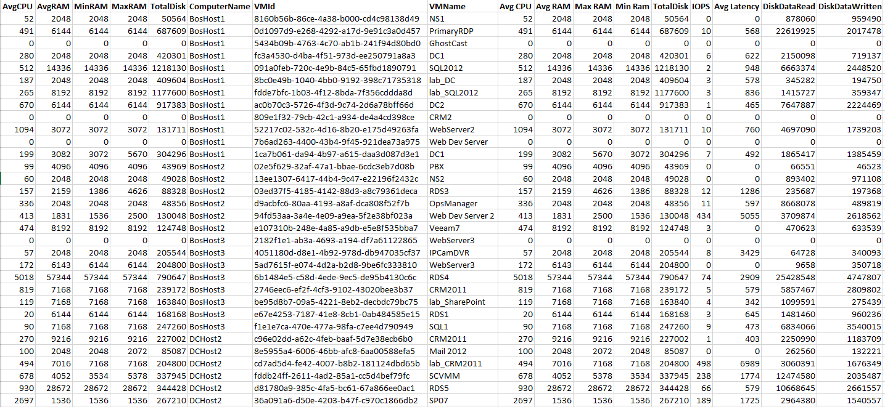
Example Export Results

Slide 18
Viewing VM IOPS
$VMHosts="localhost"
# Measure IOPS on All VMs
$a = @{Expression={$_.vmname};Label="VM Name";width=25},
@{Expression={$_.AggregatedAverageNormalizedIOPS};Label="VM IOPS";width=8},
@{Expression={$_.avgcpu};Label="Avg CPU";width=10}
get-vm -computer $VMHosts | where {$_.state -eq 'running'} | measure-VM | Format-Table $a

Slide 19
Example Script
######################
## GET-VM ##
######################
# View VM Status
cls; Get-VM -ComputerName localhost
#View Status of a single VM
Get-VM -ComputerName localhost -Name "Audit PC 1"
#View VM Status for Running VMs Only
Get-VM -ComputerName localhost | Where { $_.State –eq ‘Running’ }
######################
## START/STOP VMs ##
######################
# Start all VMs
Start-VM -ComputerName localhost -Name *
# Stop all VMs
Stop-VM -ComputerName localhost -Name *
######################
## MEASURE-VM ##
######################
# Enable VM Resource Metering for all VMs on Host
get-vm -ComputerName localhost | enable-VMResourceMetering
Measure-VM -ComputerName localhost -Name "Audit PC 1"
Measure-VM -ComputerName localhost -Name *
######################
## BRING TOGETHER ##
######################
Get-VM | Where { $_.State –eq ‘Running’ } | Measure-VM
######################
## SEND IT TO CSV ##
######################
# WRITE VM INFO TO CSV
$file_info_current = 'C:\VM-Info_current.csv'
del $file_info_current # Deletes previous copy of CSV #
Get-VM -ComputerName localhost | select name , processorcount, MemoryAssigned, ReplicationHealth, Uptime, ComputerName, State, VMID | export-csv -NoTypeInformation $file_info_current
start $file_info_current
# WRITE VM USAGE TO CSV
$file_usage_current='C:\VM-Usage_current.csv'
del $file_usage_current # Deletes previous copy of CSV #
get-vm -ComputerName localhost | Measure-VM | export-csv -NoTypeInformation $file_usage_current
start $file_usage_current
# Reset VM Resource Metering for all VMs on Host
Reset-VMResourceMetering -vmname * -computername localhost

Slide 20

Next Steps
Take these code snippets and make them serve your own purpose
Monitor usage of multiple VMs on multiple hosts

Slide 21
Giveaway: $100 of Azure Credit for 1 month
See Bob for code. Expires 8/28/2017
DO NOT redeem promo code with an email account that is attached to an EA (electronic agreement), the pass will not work.
Promo code needs to be redeemed within by expiration date listed.
Only one promo code can be redeemed per the lifetime of a Live ID/Org ID.
Monetary credit can't be used toward third party services, premier support or Azure MarketPlace and cannot be added to existing subscriptions.
Accounts cannot be extended - the duration and monetary credit amount cannot be altered
If you remove the monetary cap by providing a payment instrument, you will be converted to a 'Pay-as-you-go' account at the end of the offer duration. However, if the account has expired, you will need to create a support ticket to enable conversion.
Offers are not customizable.
Subscriptions are activated within minutes of the promo code being redeemed.
To redeem a promo code, visit www.microsoftazurepass.com

Slide 22
Questions?

